Slide 1
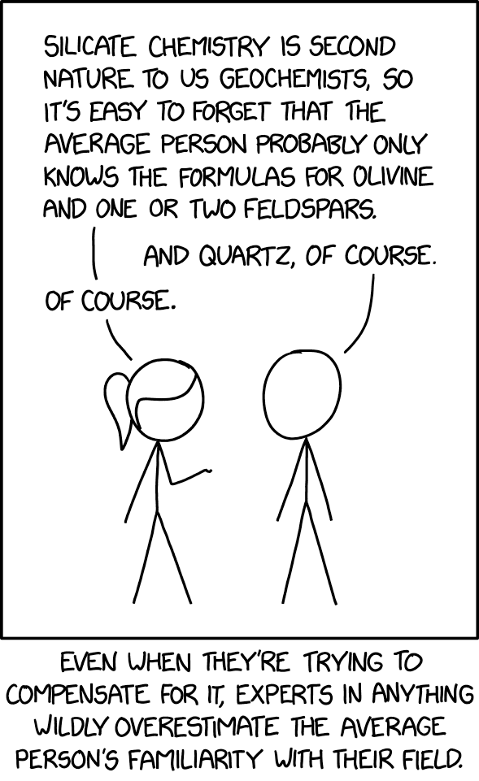
Federated Learning
22-5-2025
Stijn de Boer
A hands-on introduction to federated learning with the PCNtoolkit

Slide 2

About me
MSc. In AI at Radboud University (2022)
Master thesis at the Donders under supervision of prof. Andre Marquand: Non-Gaussian Normative Modelling with Hierarchical Bayesian Regression
Member of the Sectorplan: Data-driven Innovation team at the Radboud UMC, which brings together experts from medical and data/AI backgrounds
Working on federated learning techniques since 2021

Slide 3
Goal of this workshop
Part 1:
Understanding the need for federated learning (FL)
Learn the core concept
Example: Federated Deep Learning
Example: Federated Bayesian Modelling
Part 2:
FL demonstration using the PCNtoolkit

Slide 4
Understanding the need for federated learning

Slide 5


Data privacy & regulatory landscape
Understanding the need for federated learning
1996 – HIPAA (US)
Regulates the use of protected health information (PHI)
Medical ML research can never expose or transfer PHI
2016 – GDPR (EU)
Restricts processing, storage, and sharing of personal data
Centralized ML often violates GDPR
A total of €5.88 billion in fines has been imposed (€2.3bn on Meta)
2018 – CCPA (California US)
Not US-wide, but regulates 40 million Americans and 500.000 businesses
Inspired regulatory action in other states; Nevada, Maine, Conneticut, Washington, New York
2025 – Executive Orders
Large-scale data removal from public institutions (CDC, NIH)
ABCD dataset access tightened – largest long-term US study of brain development
Clear trend → Distribution of data is becoming increasingly difficult
Notes:
HIPAA: The Health Insurance Portability and Accountability Act
GDPR: General data protection regulation
CCPA: California Consumer Privacy Act
CDC: Center for Disease Control and Prevention
NIH: National Intitutes of Health ABCD: Adolescent Brain Cognitive Development
Meta: 2.3 Billion

Slide 6
Case study: ABCD dataset
Understanding the need for federated learning
Adolescent Brain Cognitive Development study
Largest long term study of child brain development in the US.
Started in 2016, aims to follow 12.000 children for 10 years
Includes MRI scans, cognitive testing, genetic data, family background, mental health, substance use, ...
Executive order under the current US administration resulted in:
Removal of thousands of public CDC/NIH websites
Restricted access to behavioral health and adolescent datasets (like ABCD)
Classification of some research areas as politically sensitive (like sexual preference)
Implications
Sudden loss of open data access
New boundaries for data sharing even within the US
Removal of politically sensitive features from new versions of the ABCD dataset
Uncertainty and mistrust about data stability
Notes:
HIPAA: The Health Insurance Portability and Accountability Act
GDPR: General data protection regulation
CCPA: California Consumer Privacy Act
CDC: Center for Disease Control and Prevention
NIH: National Intitutes of Health ABCD: Adolescent Brain Cognitive Development

Slide 7
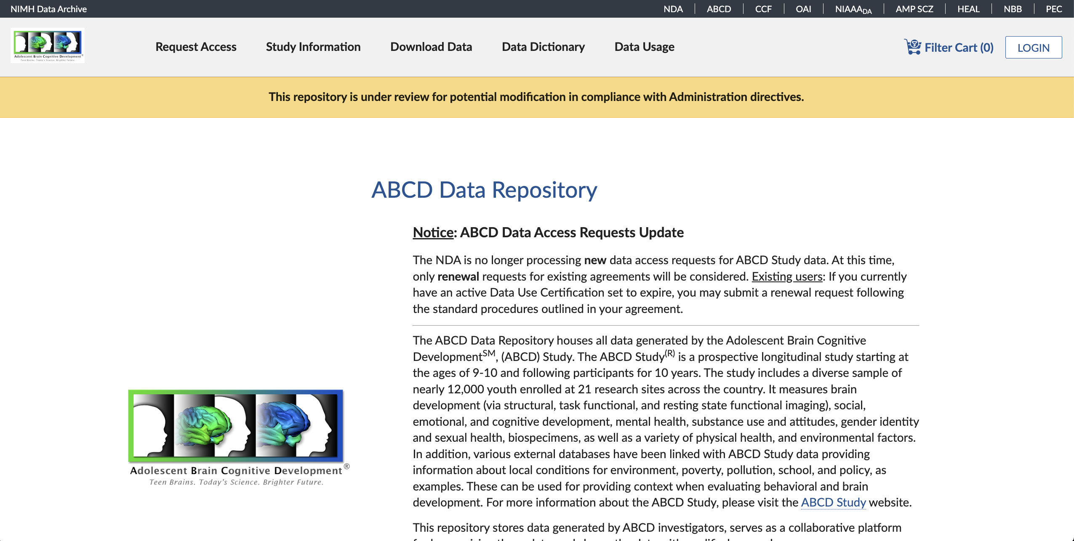
Case study: ABCD dataset
Understanding the need for federated learning
Notes:
HIPAA: The Health Insurance Portability and Accountability Act
GDPR: General data protection regulation
CCPA: California Consumer Privacy Act
CDC: Center for Disease Control and Prevention
NIH: National Intitutes of Health ABCD: Adolescent Brain Cognitive Development

Slide 8

Institutional Barriers
Understanding the need for federated learning
Institutional barriers:
Ethics boards are reluctant to approve data sharing
Differences in privacy laws create legal deadlocks
Sharing may violate consent boundaries, or consent may expire
Bureaucracy slows things down
Other factors:
Re-identification of datasets is a risk, further increasing reluctance
Notes:
HIPAA: The Health Insurance Portability and Accountability Act
GDPR: General data protection regulation
CCPA: California Consumer Privacy Act
CDC: Center for Disease Control and Prevention
NIH: National Intitutes of Health ABCD: Adolescent Brain Cognitive Development

Slide 9

Why decentralized learning is the way forward
Understanding the need for federated learning
Centralized modelling is failing
Moving data is becoming increasingly slow and risky
Collaboration is stalling
Trust is eroding
FL as a paradigm:
Data stays local → Only models move
Privacy-by-design
Benefits:
Owners stay in control of their data
Reduces risk of data breaches
Cross-site machine learning
Notes:
HIPAA: The Health Insurance Portability and Accountability Act
GDPR: General data protection regulation
CCPA: California Consumer Privacy Act
CDC: Center for Disease Control and Prevention
NIH: National Intitutes of Health ABCD: Adolescent Brain Cognitive Development

Slide 10
What is federated learning?

Slide 11
Core definition and concept
What is federated learning
In general:
The data never leaves the owner
Only model parameters/parameter updates are shared
Models are fitted where the data is located
Centralized or distributed model/parameter aggregation
Not the same as distributed computing
Assumption of data heterogeneity
Notes:
HIPAA: The Health Insurance Portability and Accountability Act
GDPR: General data protection regulation
CCPA: California Consumer Privacy Act
CDC: Center for Disease Control and Prevention
NIH: National Intitutes of Health ABCD: Adolescent Brain Cognitive Development

Slide 12
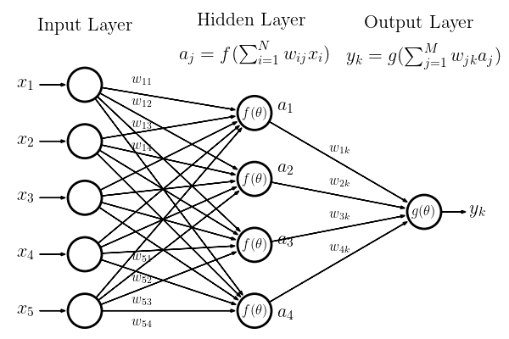

Federated learning in artificial Neural networks
What is federated learning
Neural networks
The technology that drives LLMs like ChatGPT
Gradient optimization of potentially millions of parameters
Requires large amounts of data
Challenges in FL setting
Catastrophic forgetting
Notes:
HIPAA: The Health Insurance Portability and Accountability Act
GDPR: General data protection regulation
CCPA: California Consumer Privacy Act
CDC: Center for Disease Control and Prevention
NIH: National Intitutes of Health ABCD: Adolescent Brain Cognitive Development
IID: Independant and Identically Distributed data
Slide 11 needs NN graphic

Slide 13









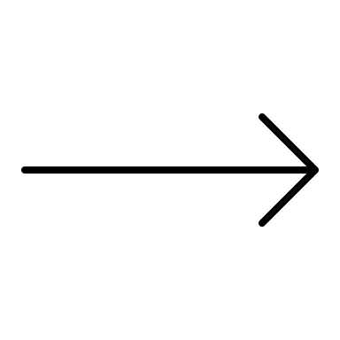
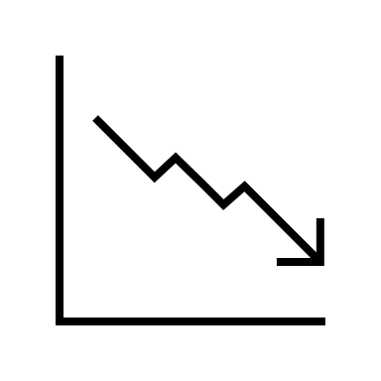

Federated learning in artificial Neural networks
What is federated learning
Idea 1:
Initiate a model
Send model to local node 1 and train on local dataset 1
Send model to local node 2 and train on local dataset 2
Send model to local node 3...
etc.
Notes:
HIPAA: The Health Insurance Portability and Accountability Act
GDPR: General data protection regulation
CCPA: California Consumer Privacy Act
CDC: Center for Disease Control and Prevention
NIH: National Intitutes of Health ABCD: Adolescent Brain Cognitive Development
IID: Independant and Identically Distributed data
Slide 11 needs NN graphic

Slide 14

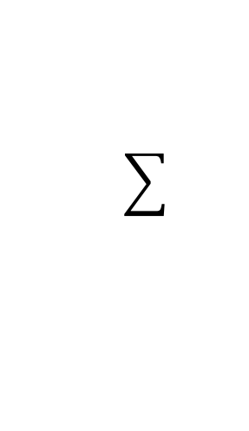
Federated learning in artificial Neural networks
What is federated learning
Idea 2:
Initiate a global model
Send parameters to local nodes
Compute loss and gradients on local nodes
Aggregate gradients on global server
Update the parameters
Repeat 2-5 until covergence
Problems:
Requires large bandwidth
Logistical nightmare
Convergence is tricky with non-IID data
Notes:
HIPAA: The Health Insurance Portability and Accountability Act
GDPR: General data protection regulation
CCPA: California Consumer Privacy Act
CDC: Center for Disease Control and Prevention
NIH: National Intitutes of Health ABCD: Adolescent Brain Cognitive Development
IID: Independant and Identically Distributed data

Slide 15
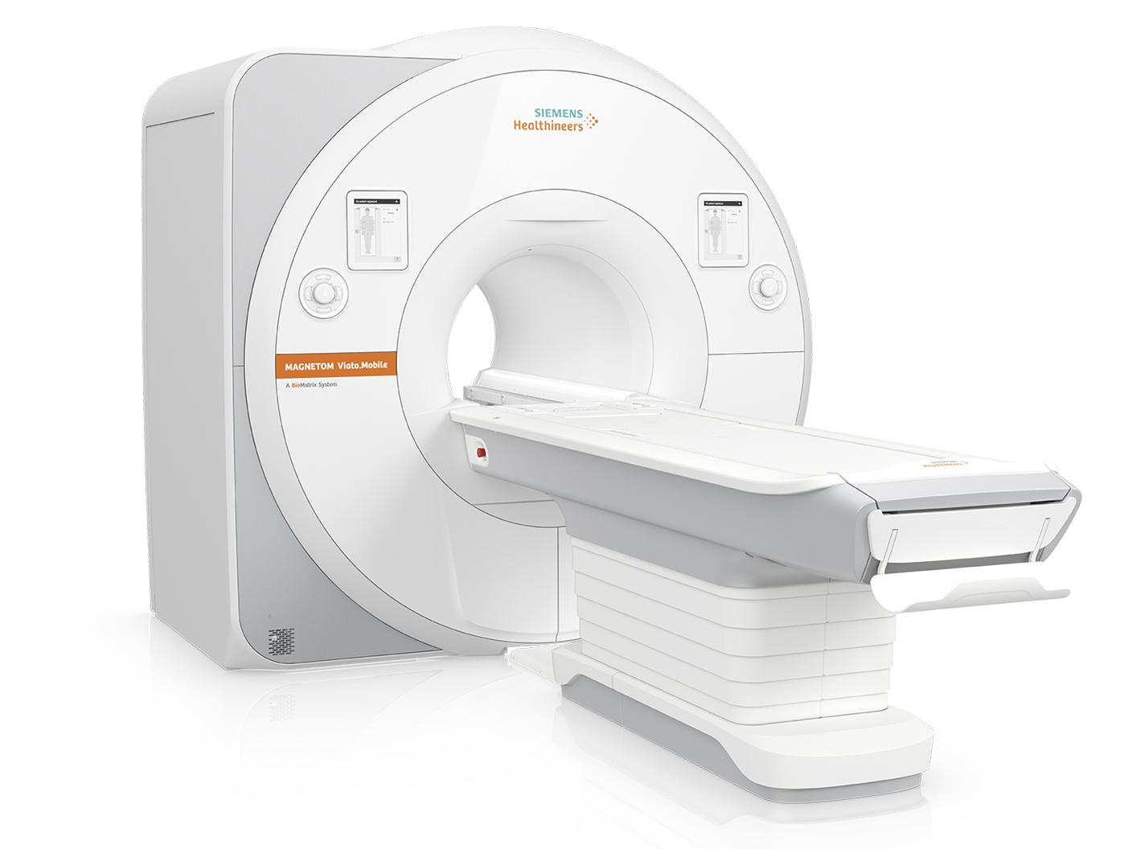
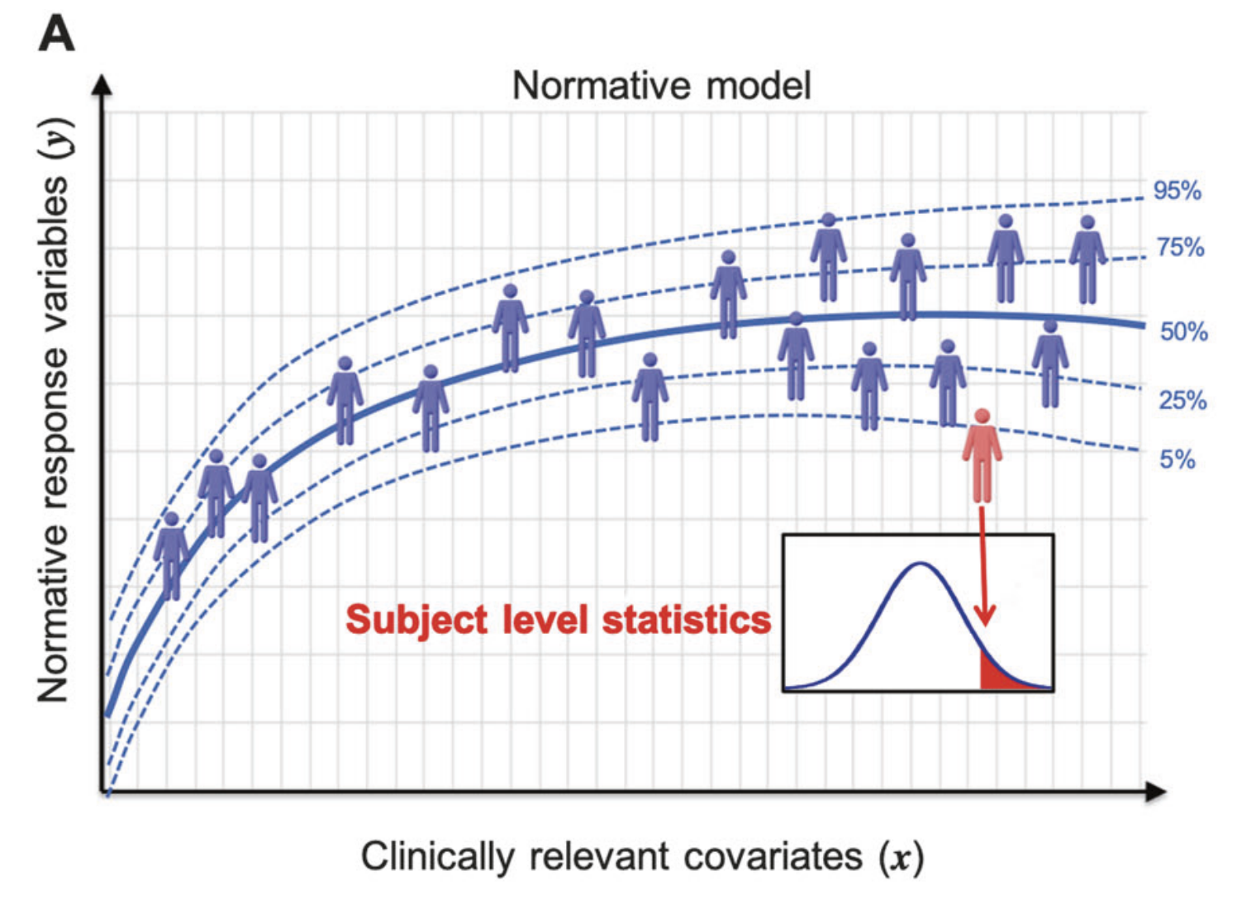
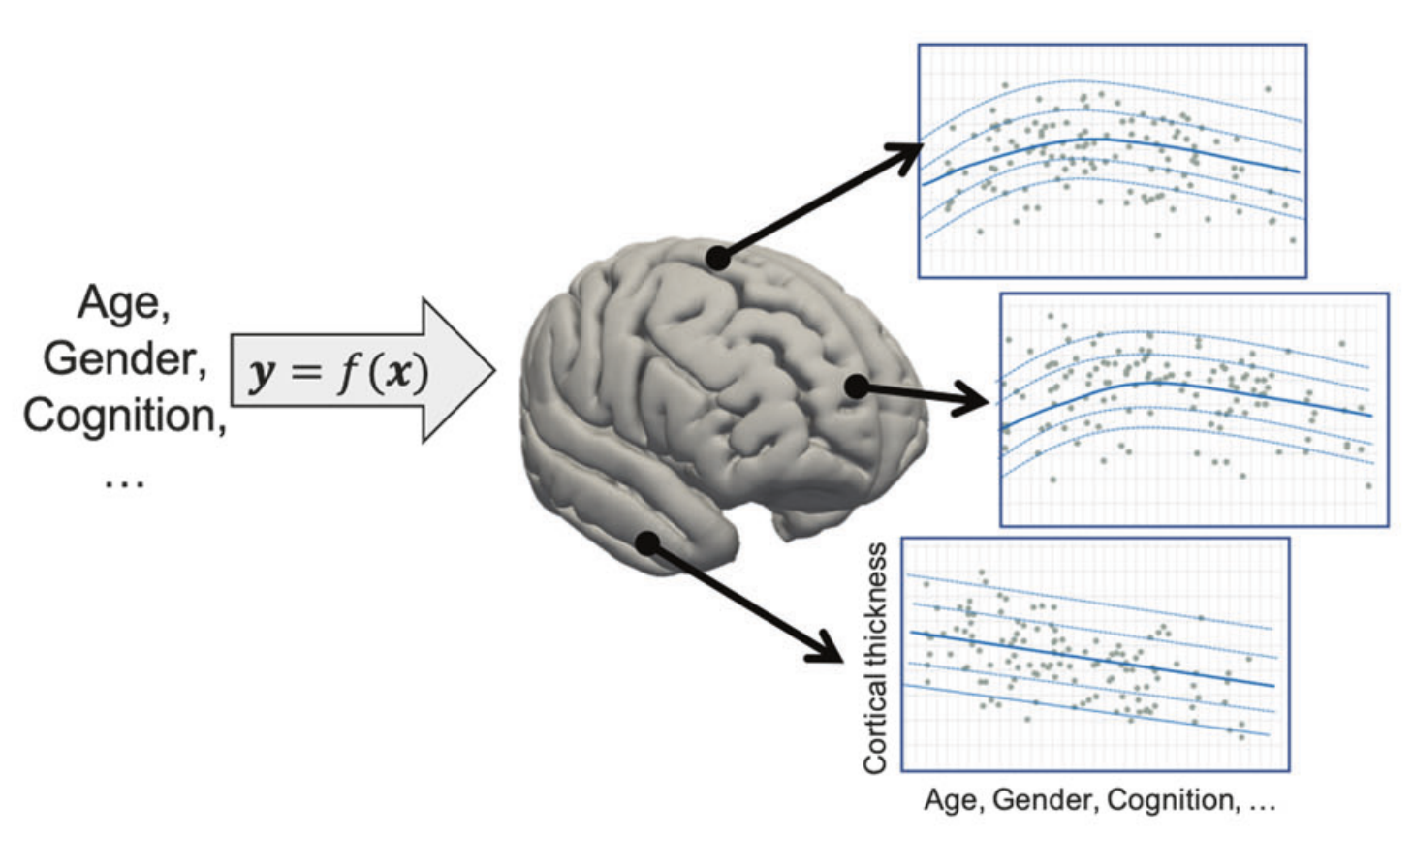
Federated learning: the bayesian approach
What is federated learning
The normative modelling paradigm:
Derive subject-level statistics using normative models based on healthy data
Healthy data from different sites → calls for FL
Marquand, Andre F., et al. "Understanding heterogeneity in clinical cohorts using normative models: beyond case-control studies." Biological psychiatry 80.7 (2016): 552-561.
Marquand, Andre F., et al. "Conceptualizing mental disorders as deviations from normative functioning." Molecular psychiatry 24.10 (2019): 1415-1424.
Notes:
HIPAA: The Health Insurance Portability and Accountability Act
GDPR: General data protection regulation
CCPA: California Consumer Privacy Act
CDC: Center for Disease Control and Prevention
NIH: National Intitutes of Health ABCD: Adolescent Brain Cognitive Development
Inductive bias

Slide 16
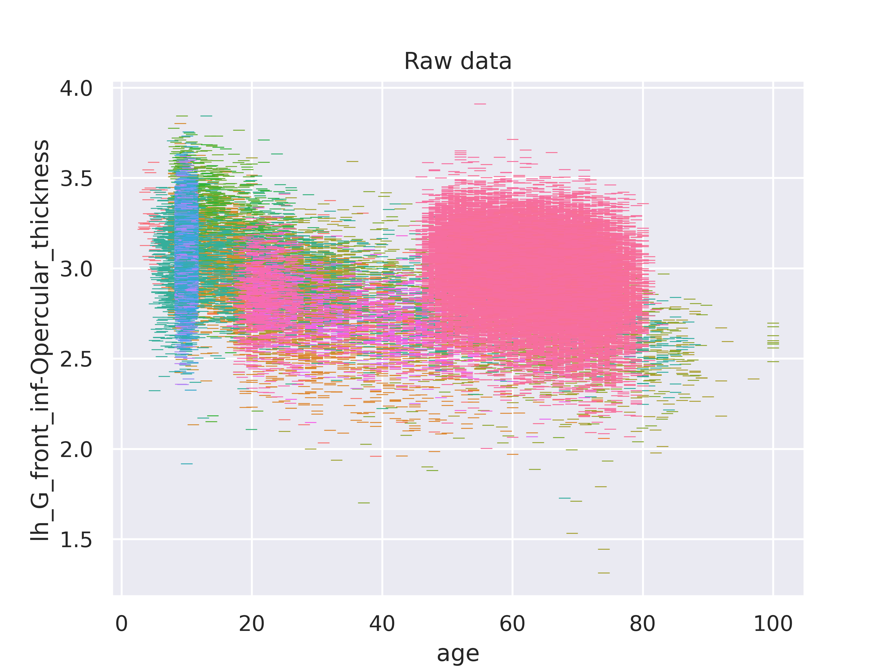
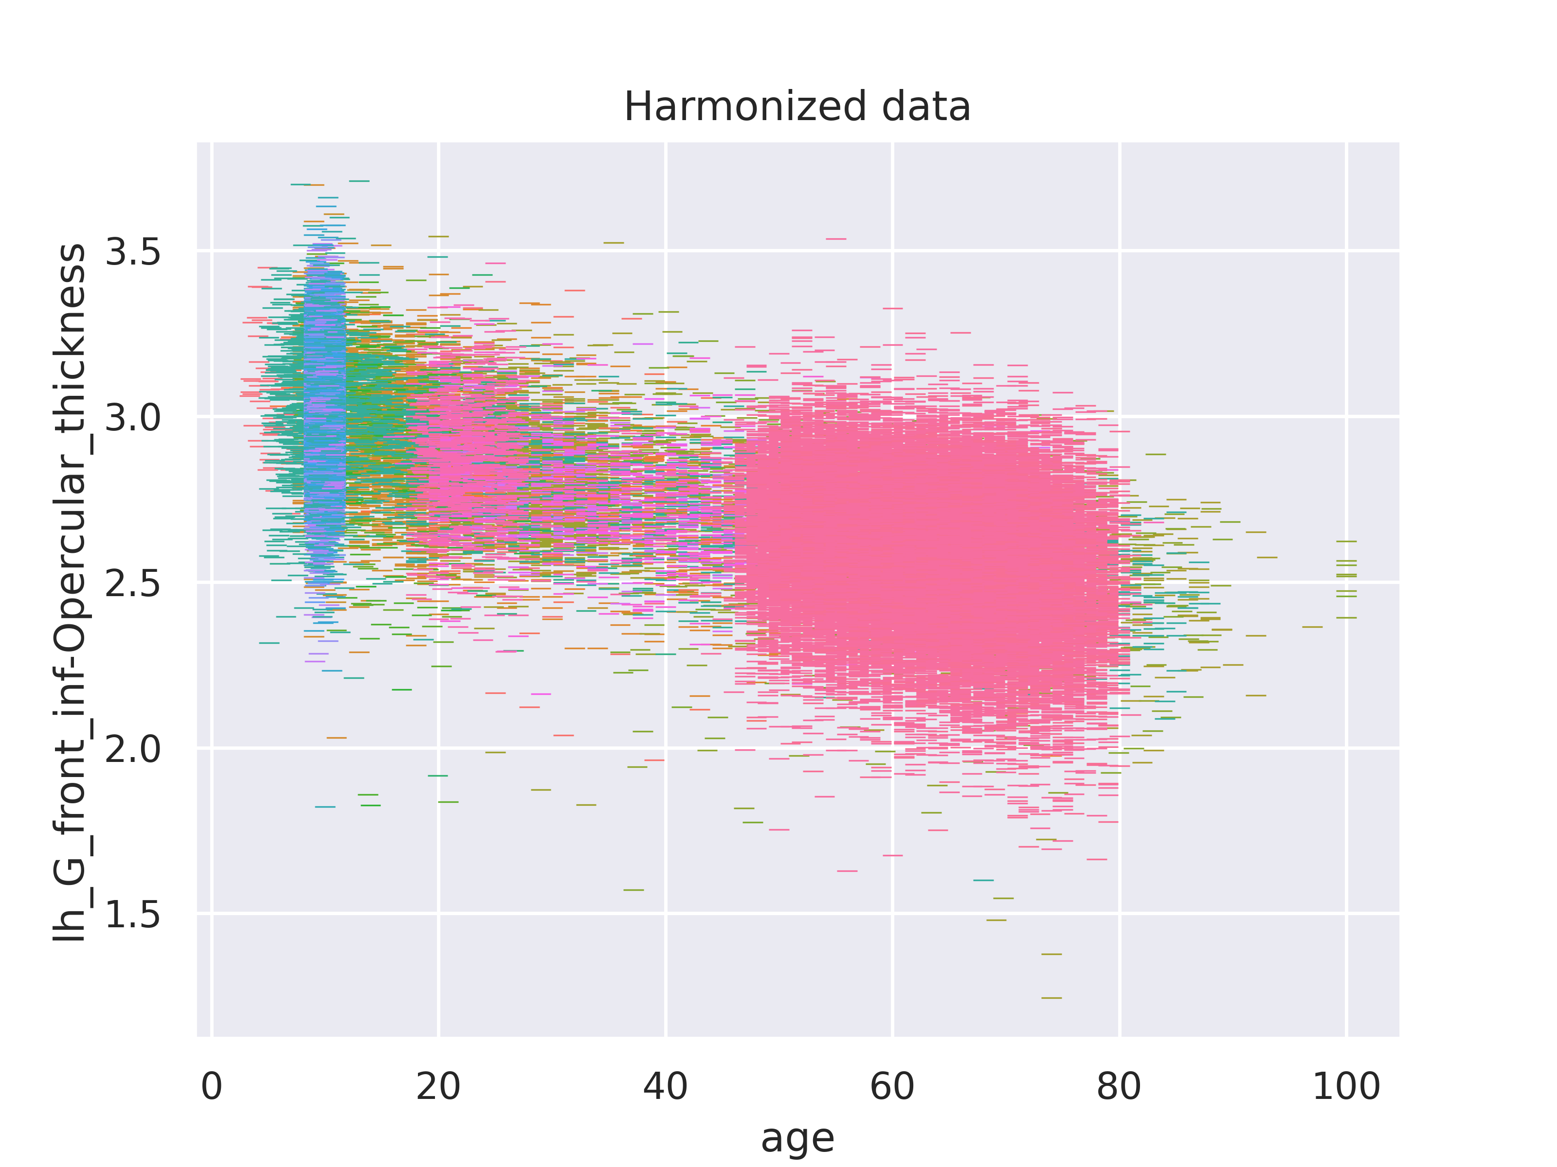

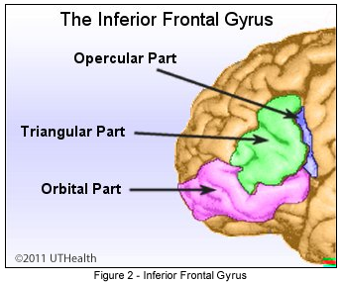
Federated learning: the bayesian approach
What is federated learning
Hierarchical Bayesian Regression for Federated Learning of Normative Models
Statistically robust way to handle site-specific characteristics
Several model-aggregation methods:
Transfer
Extend
Merge
Kia, Seyed Mostafa, et al. "Closing the life-cycle of normative modeling using federated hierarchical Bayesian regression." Plos one 17.12 (2022): e0278776.
de Boer, Augustijn AA, et al. "Non-Gaussian normative modelling with hierarchical Bayesian regression." Imaging Neuroscience 2 (2024): 1-36.
Notes:
HIPAA: The Health Insurance Portability and Accountability Act
GDPR: General data protection regulation
CCPA: California Consumer Privacy Act
CDC: Center for Disease Control and Prevention
NIH: National Intitutes of Health ABCD: Adolescent Brain Cognitive Development
Inductive bias

Slide 17



Taxonomy of bayesian federated learning
What is federated learning
Transfer
Extend
Merge
Notes:
HIPAA: The Health Insurance Portability and Accountability Act
GDPR: General data protection regulation
CCPA: California Consumer Privacy Act
CDC: Center for Disease Control and Prevention
NIH: National Intitutes of Health ABCD: Adolescent Brain Cognitive Development

Slide 18
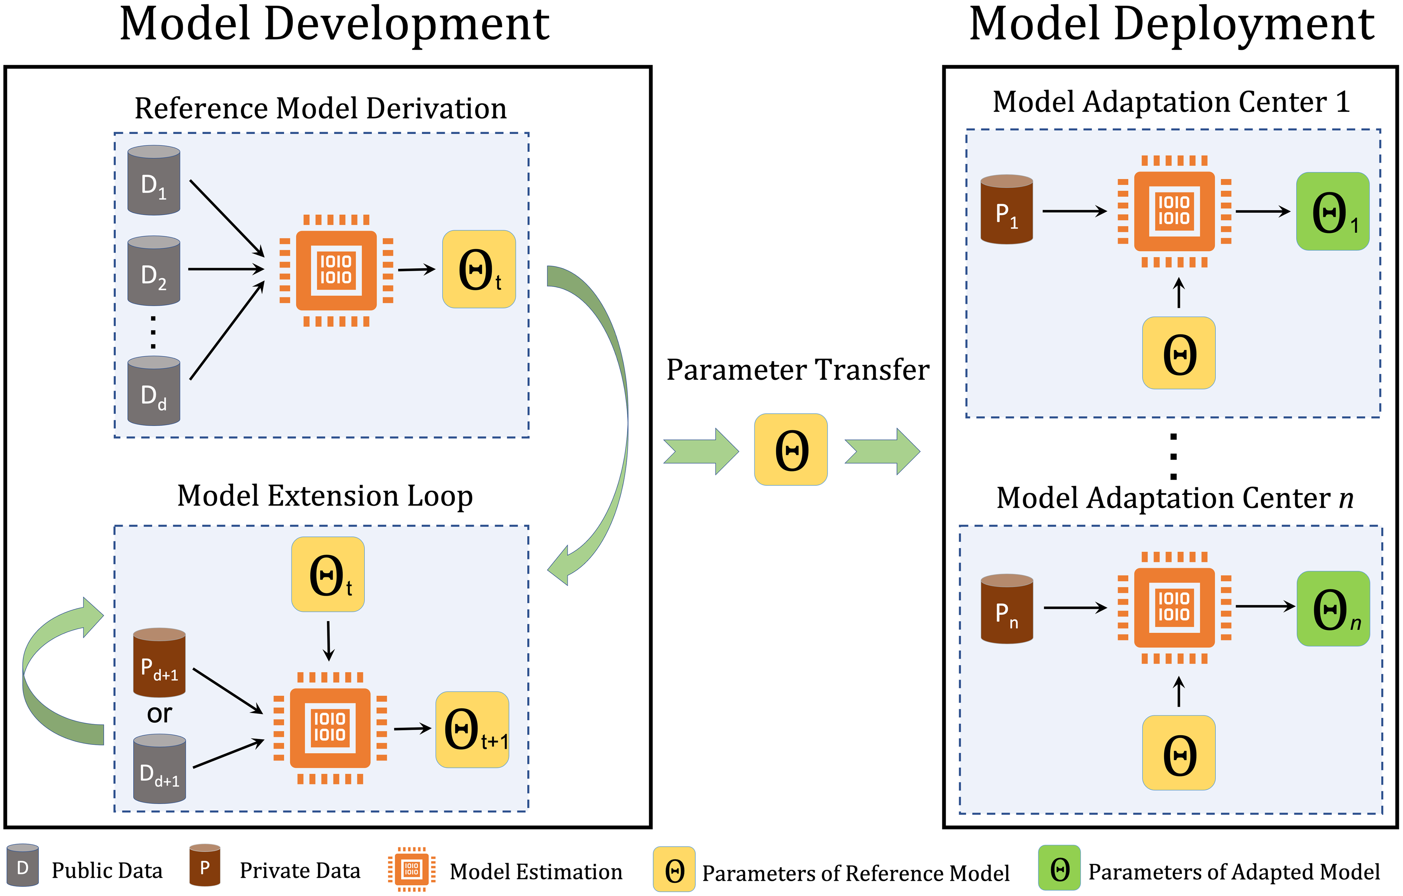
Transfer cycle
What is federated learning
Notes:
HIPAA: The Health Insurance Portability and Accountability Act
GDPR: General data protection regulation
CCPA: California Consumer Privacy Act
CDC: Center for Disease Control and Prevention
NIH: National Intitutes of Health ABCD: Adolescent Brain Cognitive Development

Slide 19
End of part 1

Slide 20
PRactical session
For those who want to follow along on their own machine, go to: https://tinyurl.com/MTE-FL-workshop And follow the setup instructions!
Notes:
HIPAA: The Health Insurance Portability and Accountability Act
GDPR: General data protection regulation
CCPA: California Consumer Privacy Act
CDC: Center for Disease Control and Prevention
NIH: National Intitutes of Health ABCD: Adolescent Brain Cognitive Development

